Slide 1

Topic A introduction to Data and data engineering

Slide 2
Introduction: data and data engineering
CONTENT
Describe Data
Describe the role of Data Engineer
Explain how the data are generated
Compare the data for transaction processing versus analytics processing
Differentiate Structure data, Unstructured data, Semi-structured data
Reference: Barton Paulson, Big Data Foundations Concepts and Techniques, LinkedIn Learning
Notes:
Teaching Tips: Introduce the overall teaching plan and the first chapter

Slide 3
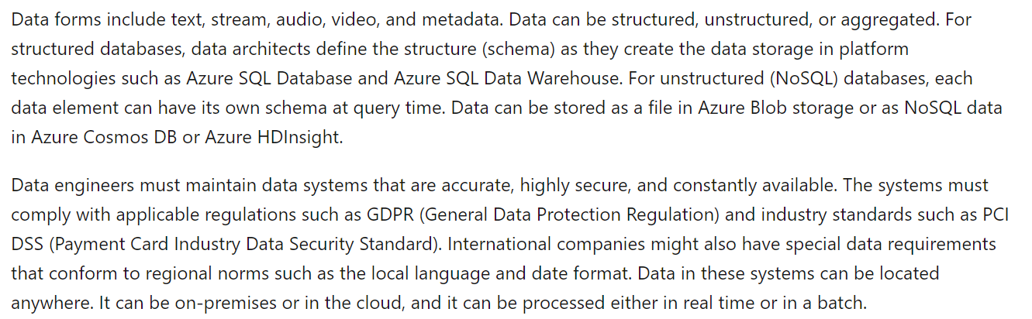
Source: https://docs.microsoft.com/en-us/learn/modules/evolving-world-of-data/2-data-abundance, 15 Nov 2019
Notes:
Teaching Notes: S
Slide 2 and 3 are definition extracted from the Microsoft Learning site. The purpose is to introduced ‘terms’ that they will used in the module.
Ask: What are terms that are new to them? (Data, Structured, Unstructured, Schema, databases, query time, data engineer

Slide 4
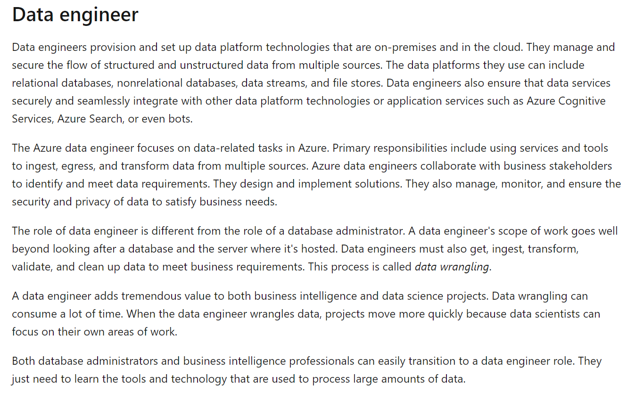

Slide 5
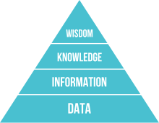
What is DATA? (DIKW Model)
Use mask
Avoid Outdoors
Carry an umbrella
Singapore West weather in the afternoon and haze reading.
Singapore Island, West, Time:13:01:05PM, PSI 210 PM 2.5 ug/m3, Temperature 32, Humidity 62%
SG-W:13:01:05:210:32:62:C

Slide 6
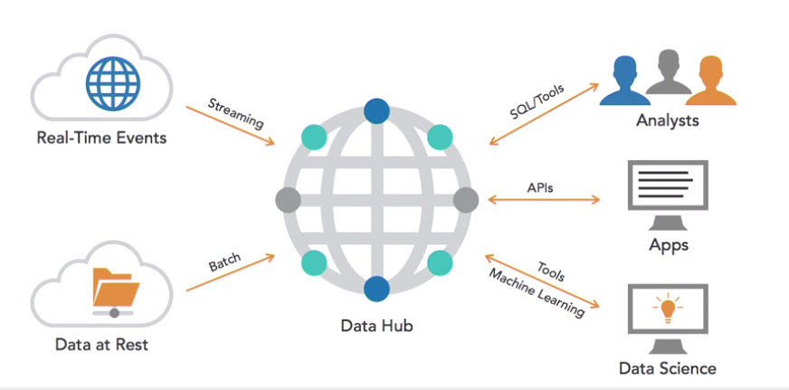
Data Engineer role
Notes:
Introduce terms such as: Database, Data Ware and Data Lake (Data Hub forms)

Slide 7

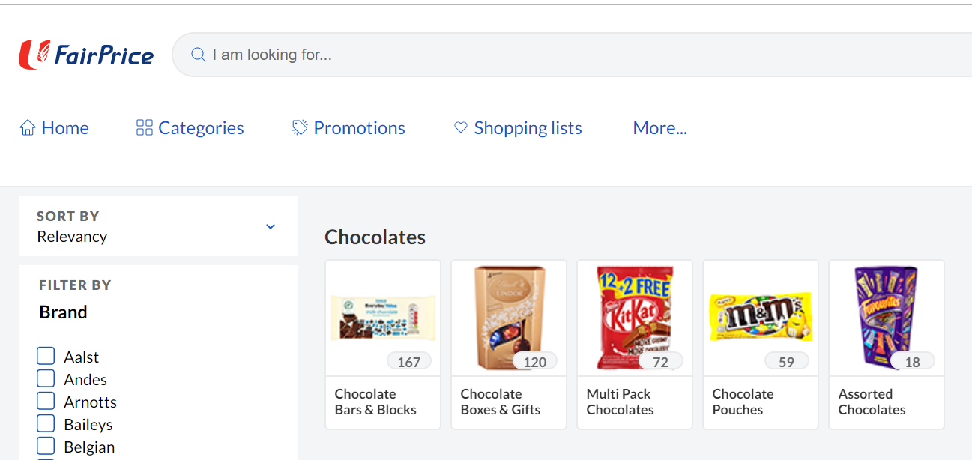
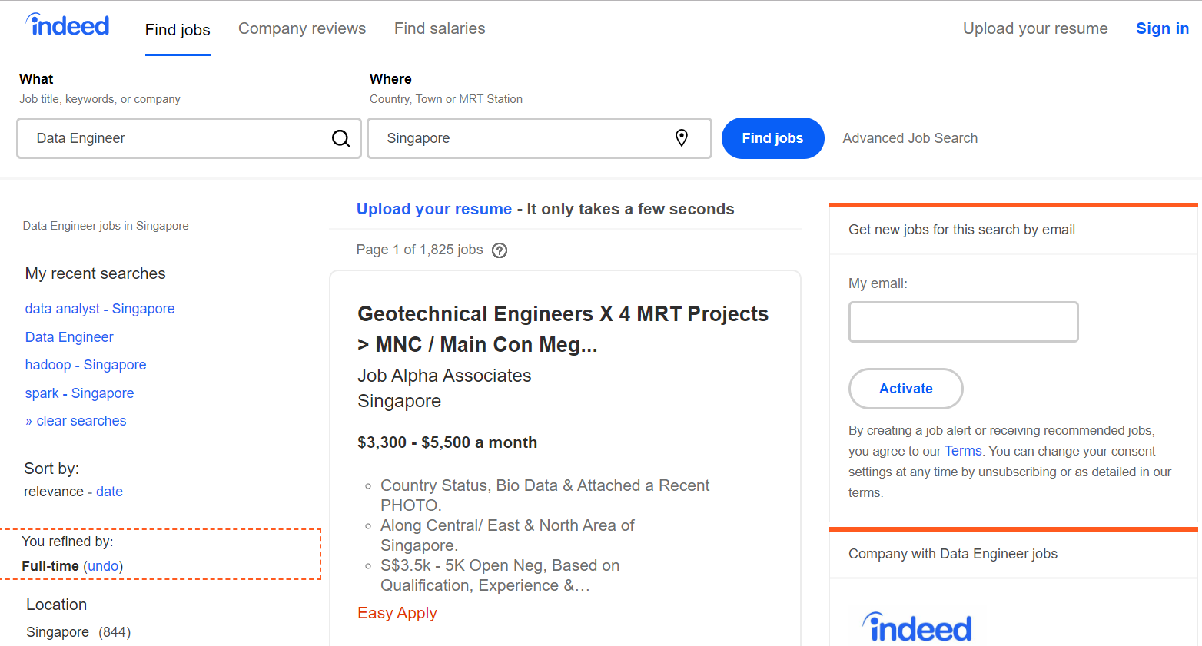
Where are the data?
Notes:
Teaching Tips:
Ask them how data are generated and collected?

Slide 8
Human-Generated data
Payment (Transaction)
Online Purchases (Transaction)
Social Media Postings
Text Messages
Cell Phone calls
….
Notes:
Teaching Tips: Differentiate between transaction-type data

Slide 9
MACHINE-Generated data
Cell Phone connect to towers
Web Crawlers
RFID Readings
IoT data
….

Slide 10
OLTP & OLAP
Online Transaction Processing
Online Analytics Processing
Handles recent operational data
Size is smaller
Goal is to perform day-to-day operations
Use simple queries
Faster processing speeds
Required read/write operations
Handles all historical data
Size is larger
Goal is to made decision from large data sources
Use complex quires
Slower processing speeds
Requires read operations
Notes:
Teaching Tips: Use the next slide to illustrate the relation between OLTP and OLAP

Slide 11
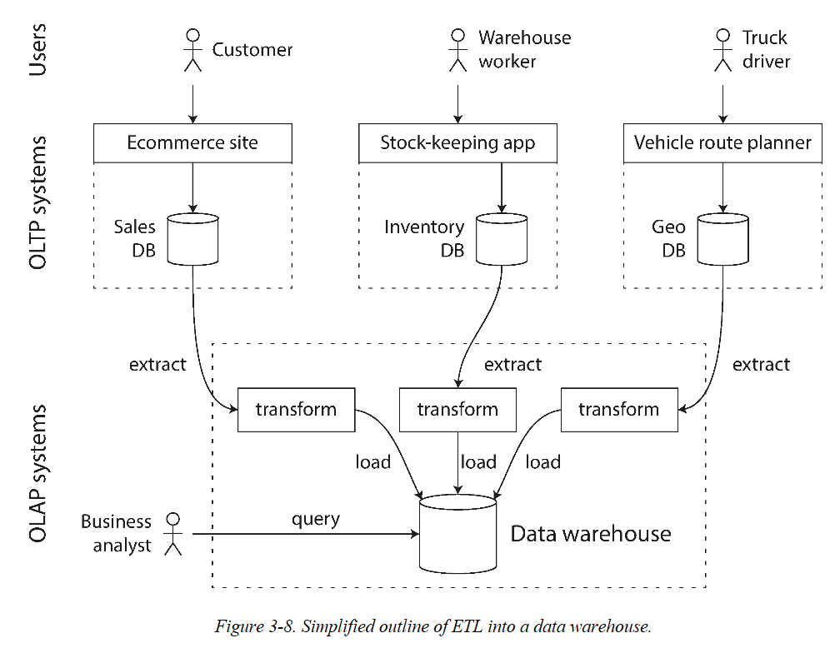
Source: Designing Data Intensive Application, Martin Kleppmann, O’relly
Notes:
Source: Designing Data Intensive Application,

Slide 12
Data Engineer role
Database,
Datawarehouse, Data Lake
Notes:
Re-Introduce the slide to explain:
Database (good for operational data, structured data)
Datawarehouse, Datalake (for analytics, unstructured data can transform to structure data?)

Slide 13
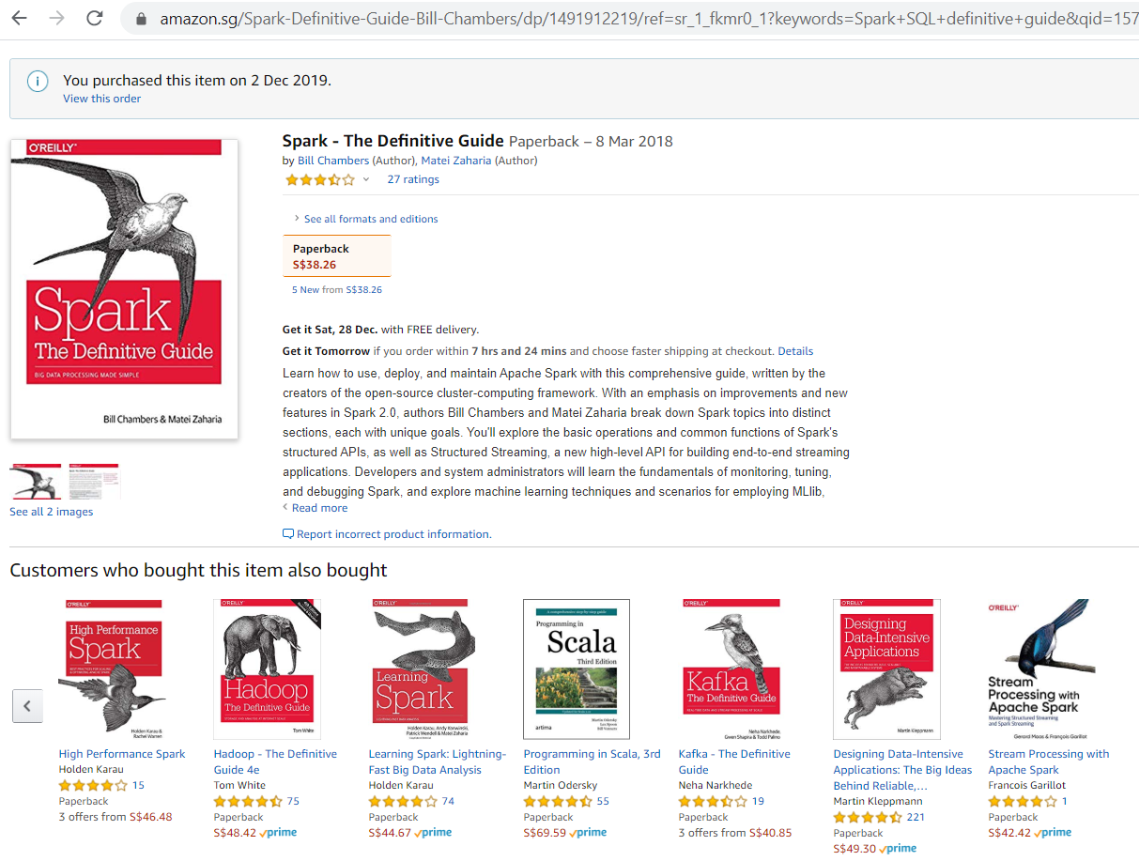
USE of DatA
Notes:
Teaching Tips: Illustrate how the historical data can be useful, why we collect we collect

Slide 14
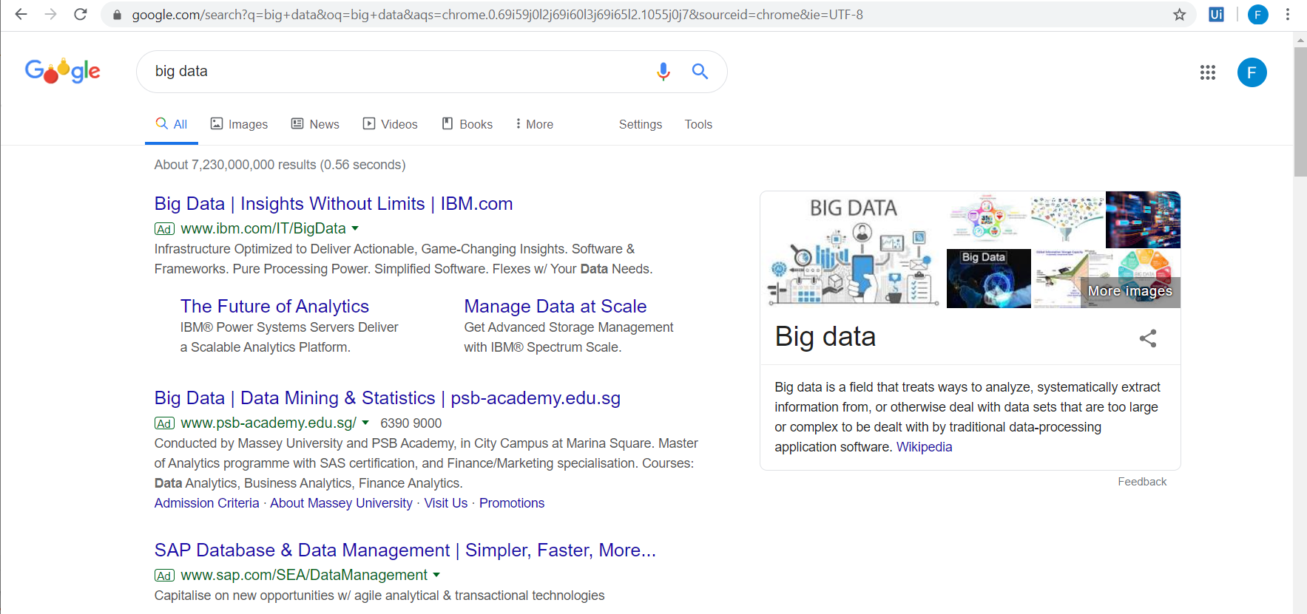
Notes:
Highlight the ‘Ad’ (relevant add) produced by the search

Slide 15


DaTa For Business
Notes:
Video: https://edited.com/#video-66 (Case: To explain how retail business uses data in their daily operation)

Slide 16
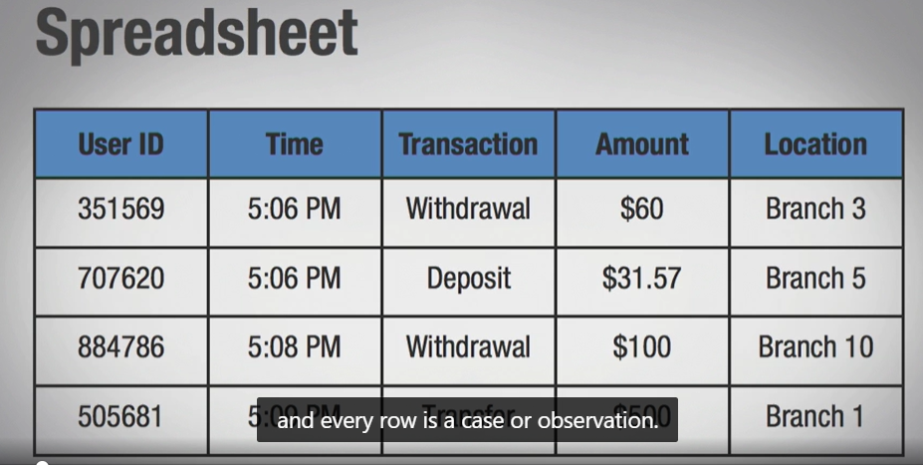
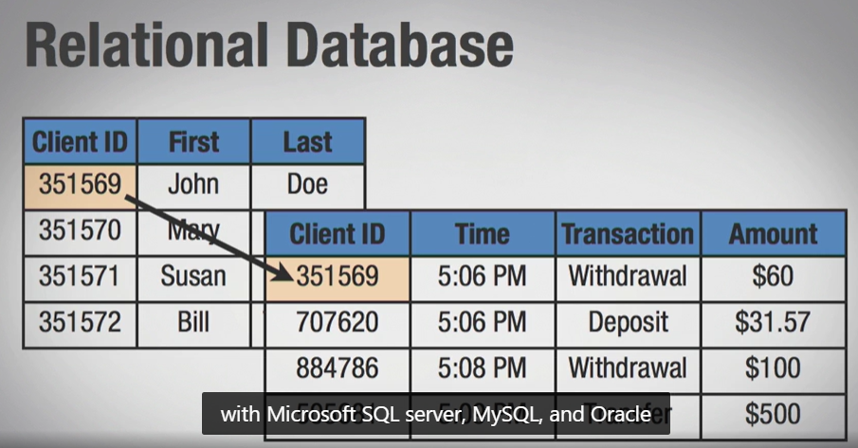
Structured, semi-structured, unstructured data
Structured Data has fixed fields.
Easier to process by machine.
Notes:
Teaching Tips, Link

Slide 17
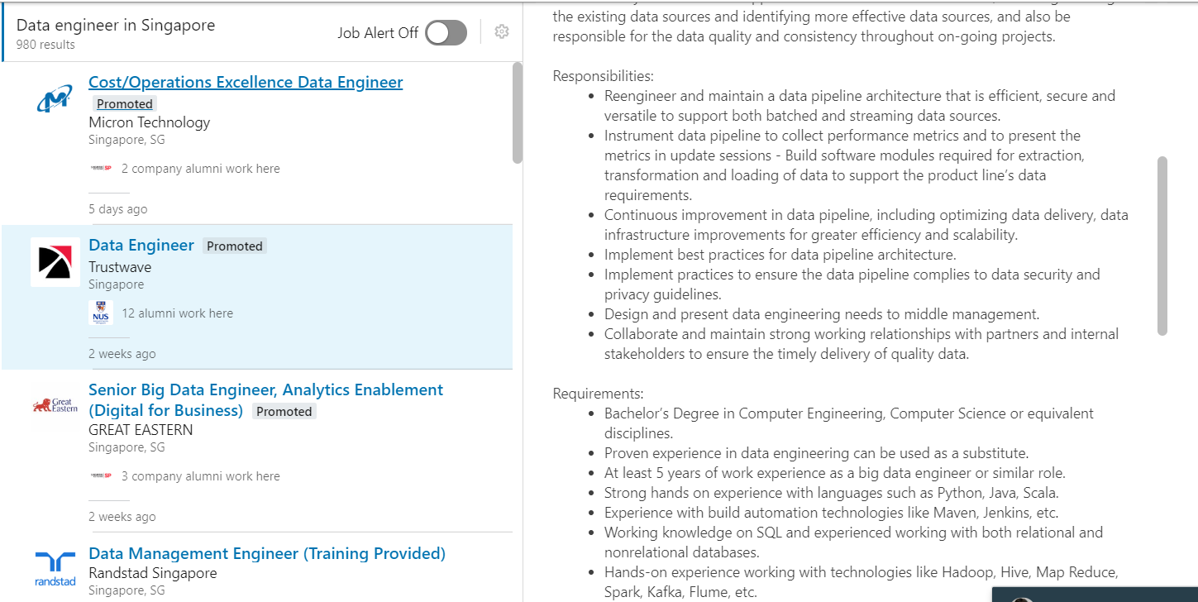
Structured, semi-structured, unstructured data
Unstructured Data does not have fixed fields
Text, images, presentations
More challenging for machine to process

Slide 18
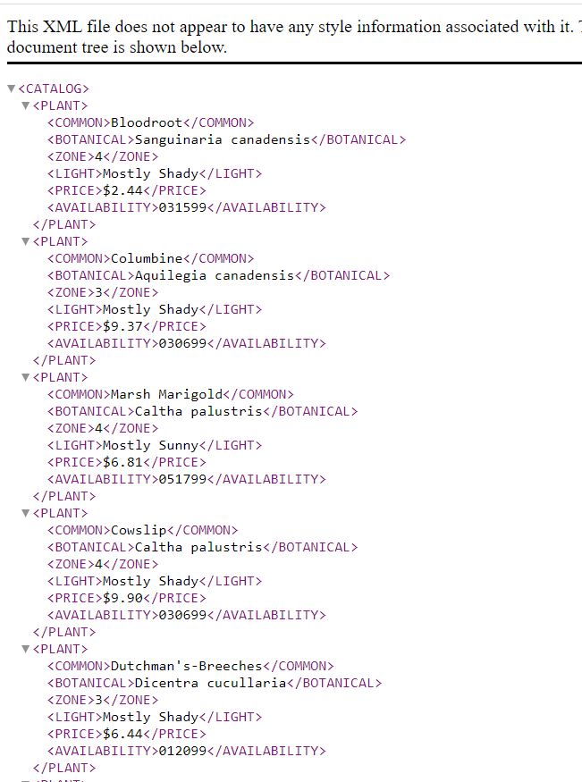
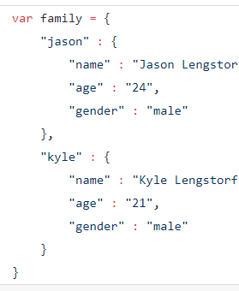
Structured, semi-structured, unstructured data
Semi-structured data does not have fixed fields
But fields are marked, data are identifiable.
Two popular formats, XML, JSON.

Slide 19
Quick Quiz
Online purchase will produce ___________________ data.
A posting on Facebook will produce ______________ data.
An online recommendation system will need ________ data.
______________ data is easier to be processed by computer.
We can define the schema (structure) of _____ data, before we use the data.
Describe the role of Data Engineer.
Notes:
Answer Keys: structured, unstructured, historical data, structured, structured.
Data Engineer: Refer to slides

Slide 20
THE END

Slide 21
